Slide 1
WIPO’s Patent Analytics activities and their integration in the TISC program
Manila
7 November 2017
Irene Kitsara, IP Information Officer
Access to Information and Knowledge Division

Slide 2
Overview – WIPO Patent Analytics activities
2010-2017
WIPO
Patent Landscape
Reports
2013-2014
Guidelines for
Preparing Patent Landscape Reports
2015-2016
Manual on Free and Open Source Tools for Patent Analytics
2016 - .....
Patent Analysis trainings in the TISCs
2017.....
Provision of patent analysis services by TISCs
2017-2018
Handbook on selected open source tools for patent analytics

Slide 3
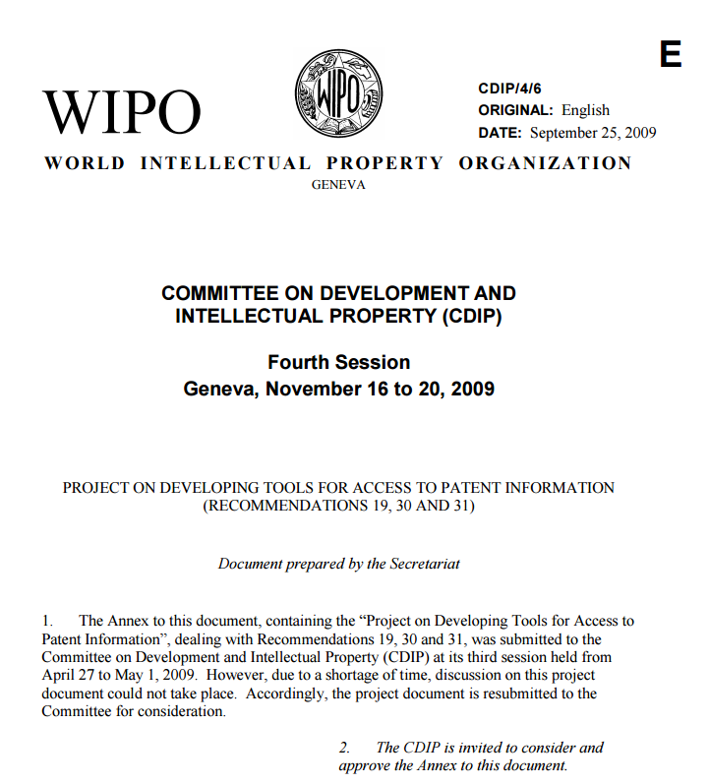
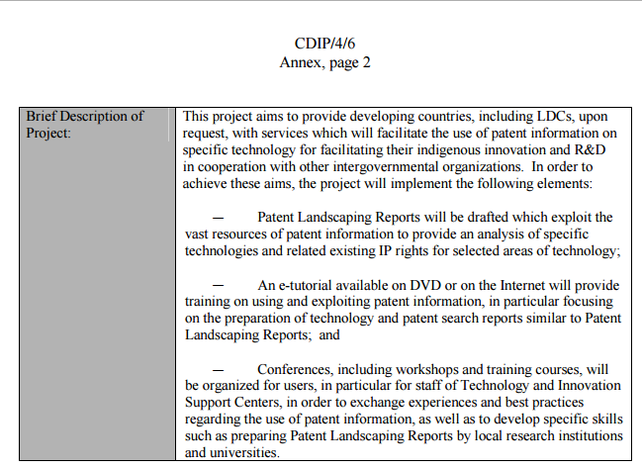
WIPO activities in patent analytics - Background
Among WIPO Strategic Goals: “Facilitating the Use of IP for Development”
Launched in 2010 as Development Agenda Project “Developing Tools for Access to Patent Information”, adopted by the CDIP (CDIP 4/6)
Since January 2014: WIPO regular activity

Slide 4
WIPO Patent Landscape Reports Project
Output: preparation of patent analysis reports in areas of importance for developing and least developed countries:
Public Health
Food and agriculture
Environment, Climate change and Energy
Disabilities

Slide 5
WIPO Patent Landscape Reports (PLR) - Approach
Demand-driven (UN-Agencies, Member States, NGOs)
Provide technical, business and legal information on the subject matter to support specific needs/decision-making
Cater for researchers, policy/decision makers, patent information users – different part of the reports address different user needs
Transparent and instructive: extensive description of the patent search methodology
Search queries
Patent search results in Excel table
Showcase various databases, methodological approaches, analysis types and analysis/visualization tools

Slide 6
WIPO PLR: cooperation partners
WIPO
WHO
AATF
Medicines Patent Pool
IRENA
FAO
GIWEH
UNEP/
Basel Convention
DNDi
CERN
MyIPO &
MPOB
OMPIC & MASCIR
UN Agencies (WHO, FAO..)
National IPOs
Research Institutes
NGOs

Slide 7


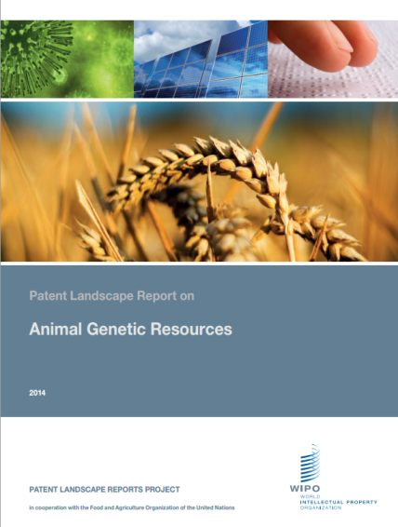
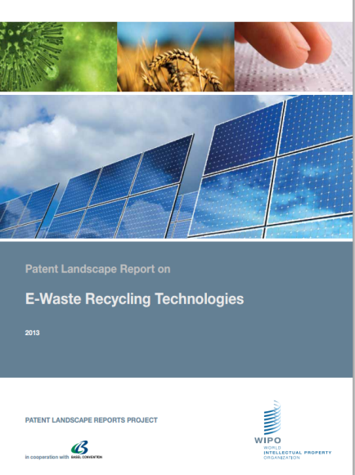

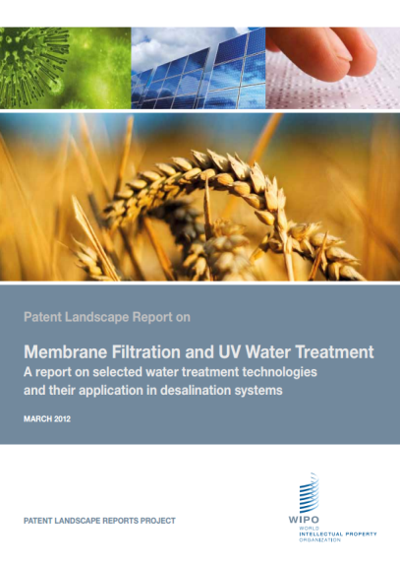


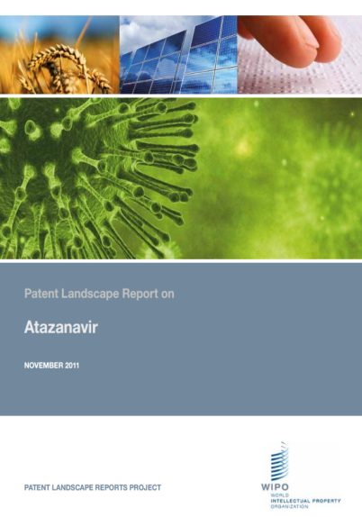
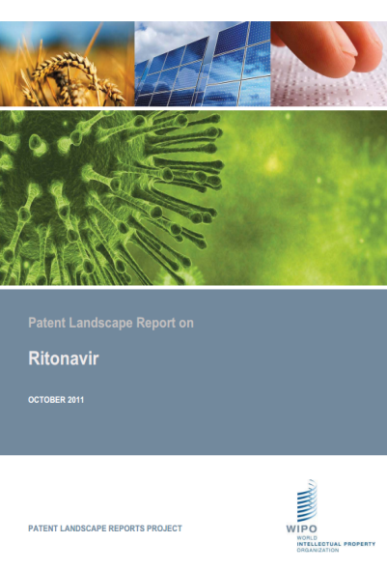
WIPO Patent Landscape Reports Topics

Slide 8
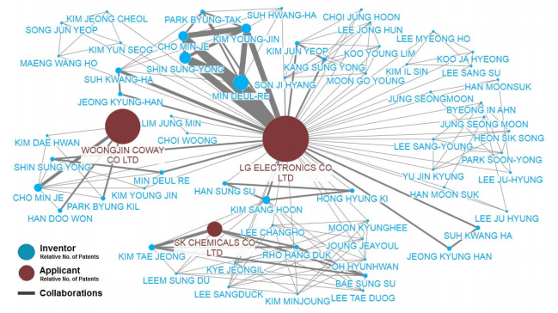
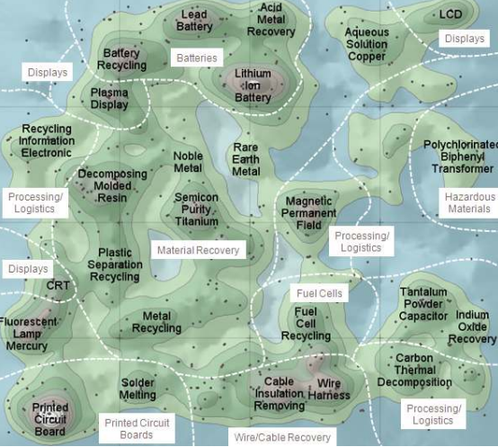
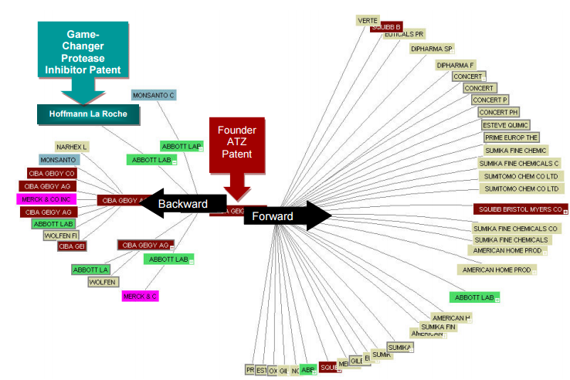
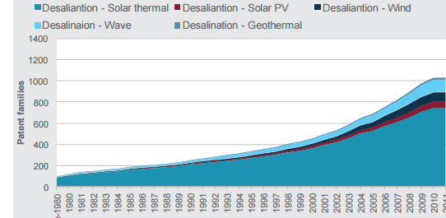
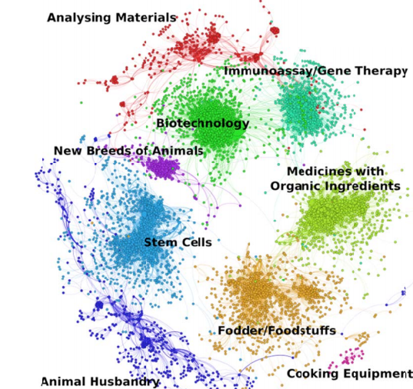
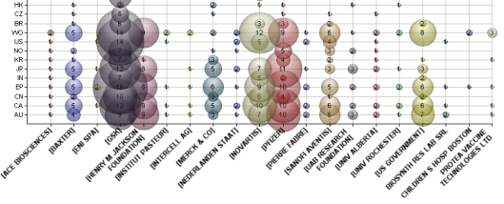
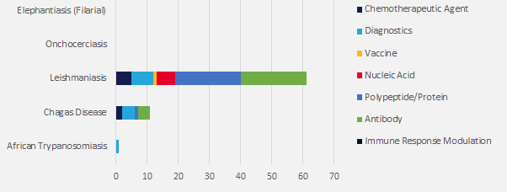
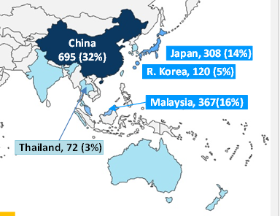
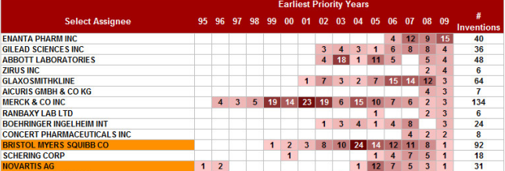
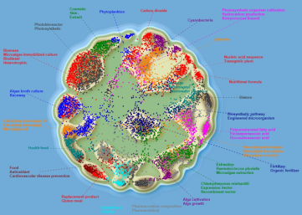
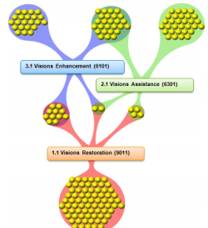
Variety in the analysis types and tools used

Slide 9
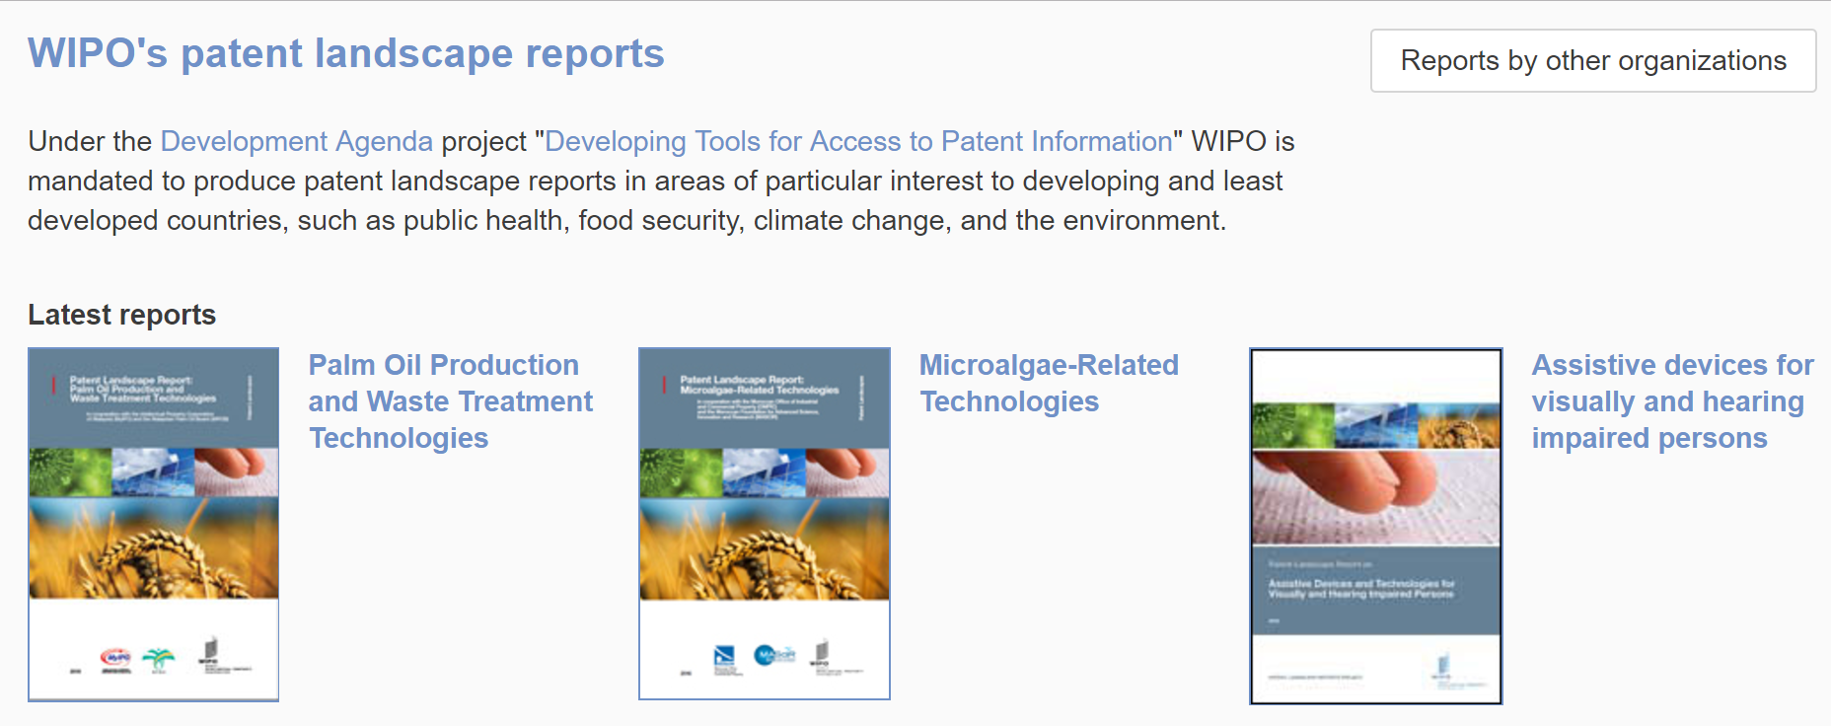
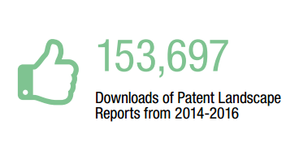
WIPO Patent Landscape Reports
http://www.wipo.int/patentscope/en/programs/patent_landscapes

Slide 10
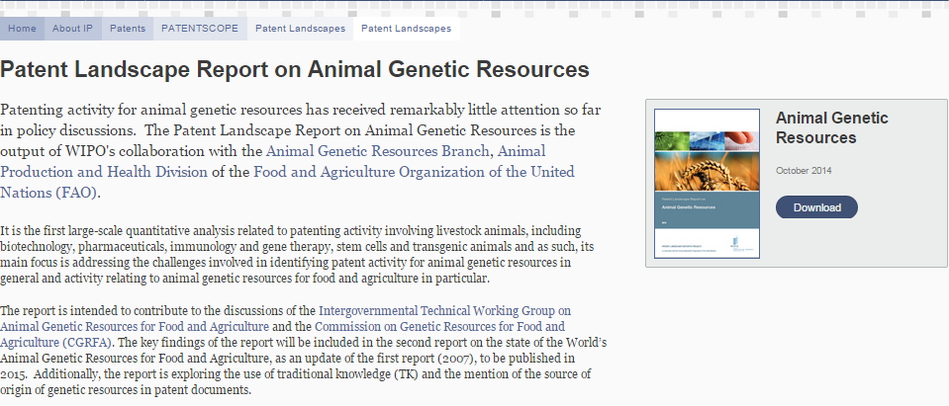
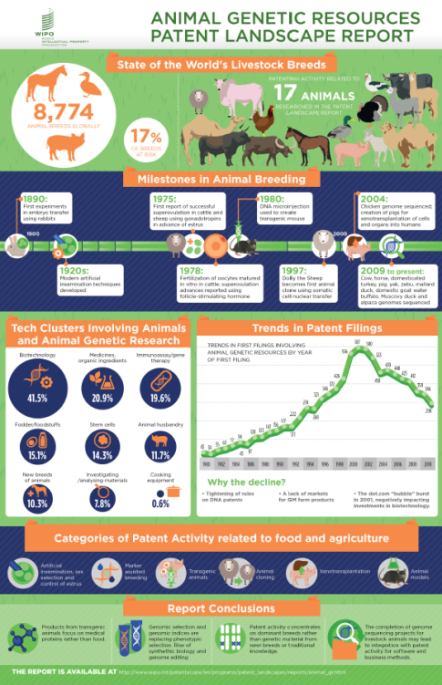
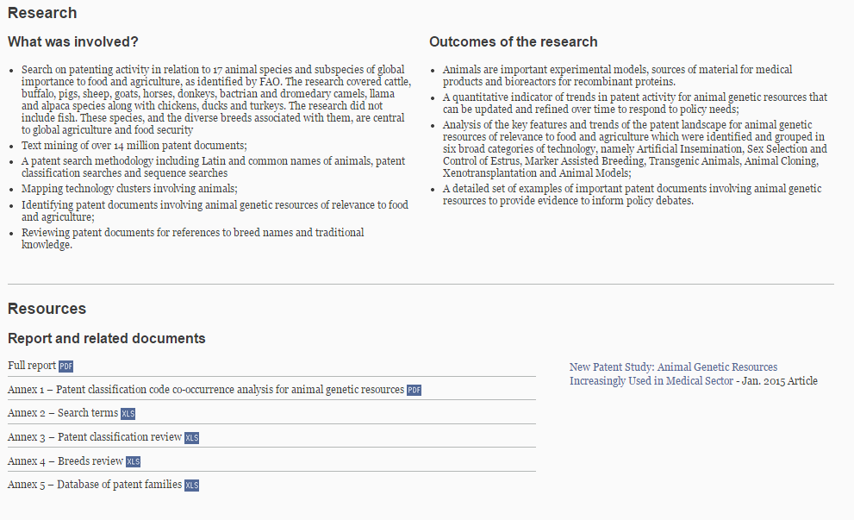
Report-specific websites

Slide 11
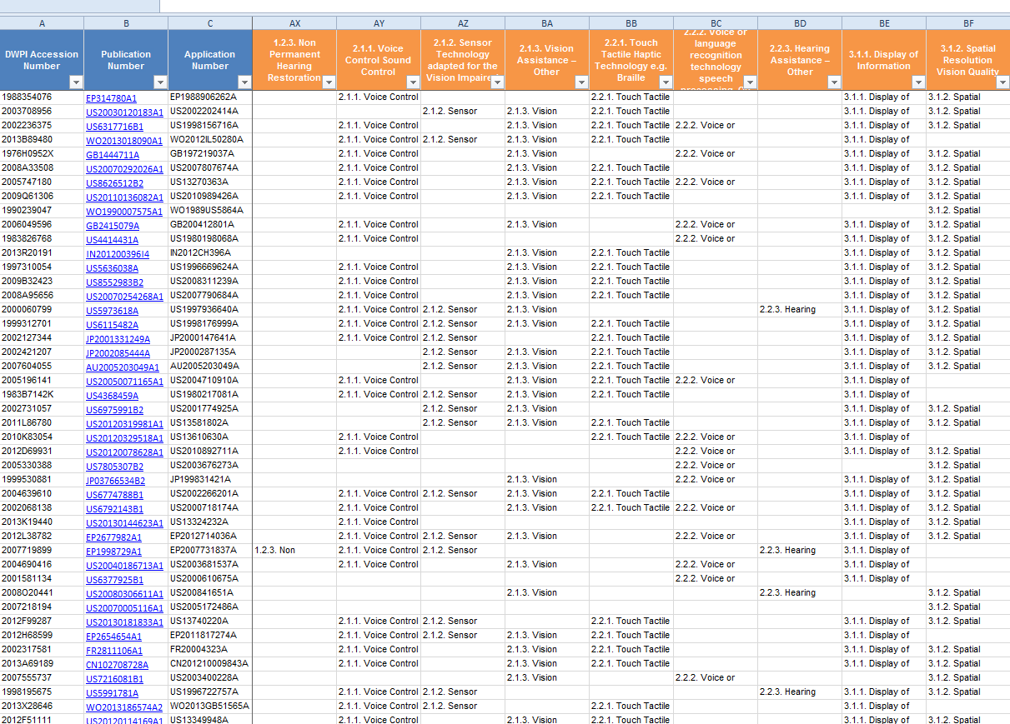
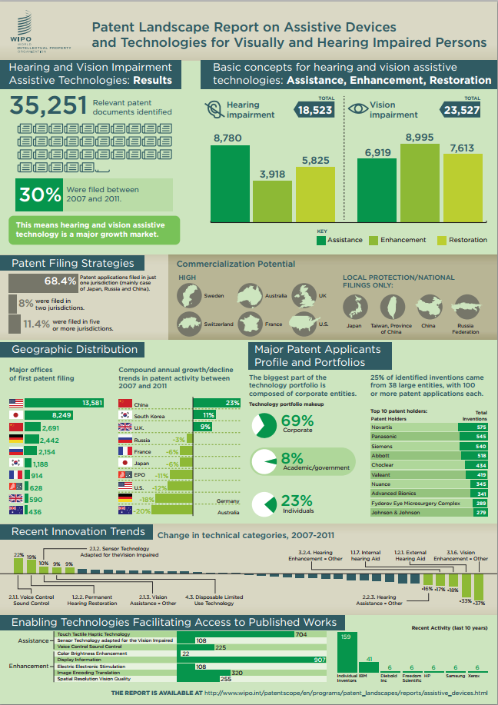
Report-specific websites (2)
Patent dataset
Infographic
Links to full documents
Documents tagged based on clusters and other grouping criteria

Slide 12






Recent and future work
Recently published:
Palm Oil Production and Waste Exploitation
Microalgae-related technologies
Patent Landscape Reports under publication:
Acccelerator technologies and their medical and industrial applications
Selected Neglected Diseases
New PLR (FIT-JP): Marine genetic resources

Slide 13
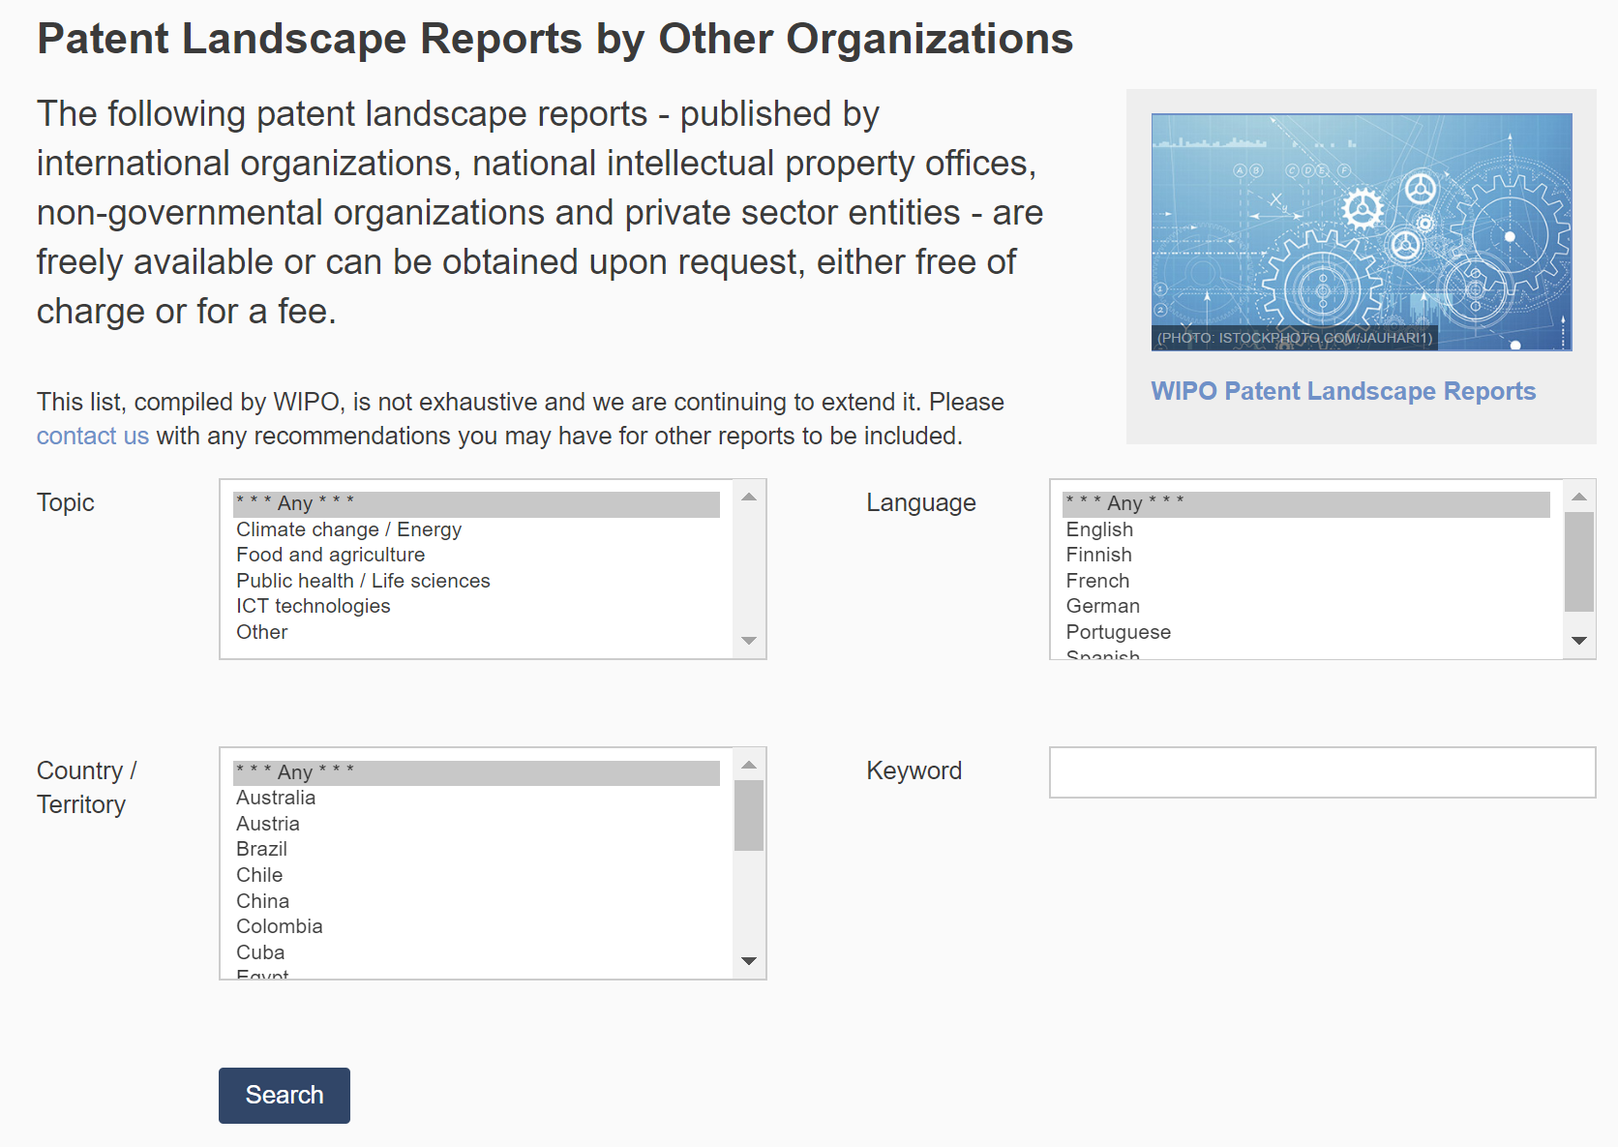
WIPO compilation of PLRs
200 reports available
www.wipo.int/patentscope/en/programs/patent_landscapes/plrdb.html

Slide 14
Guidelines for Preparing Patent Landscape Reports

Slide 15
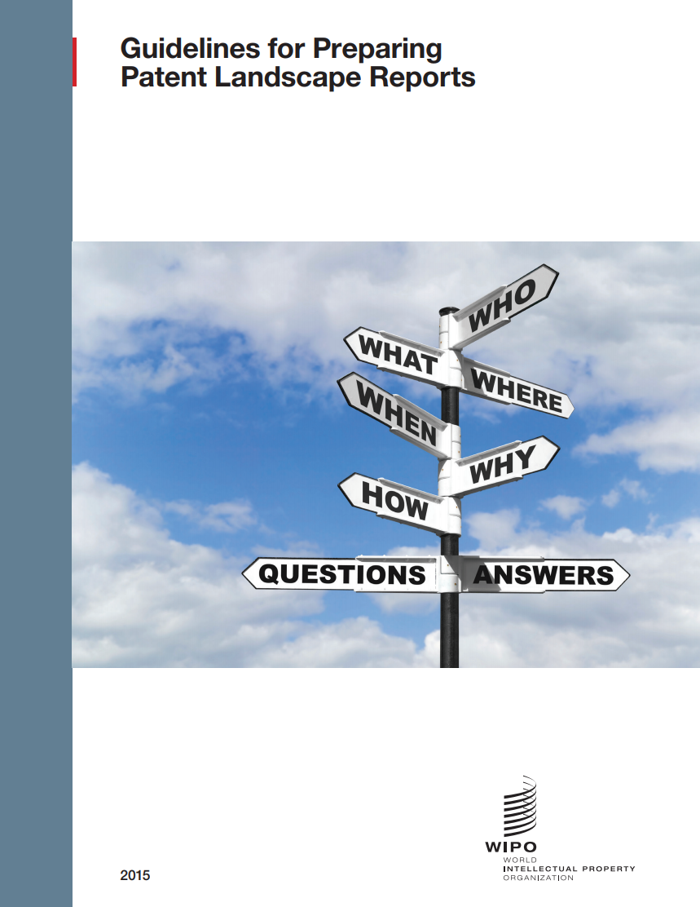
WIPO Guidelines for Preparing PLRs
Published in 2015
Patent Information Basics
Objectives of PLRs
Tasks involved in preparation of PLRs
Stages in the preparation of PLRs
Examples from WIPO’s experience
Key author: Tony Trippe
www.wipo.int/edocs/pubdocs/en/wipo_pub_946.pdf

Slide 16
Manual on free and Open Source Tools for Patent Analytics

Slide 17

The Manual on Open Source Tools for Patent Analytics
Project launched in May 2015, funded by FIT-JP
Published online in 2016
Aimed at exploring:
various free and open source tools which could be used for various patent analysis tasks by users in developing countries
Key author of the Manual: Paul Oldham
https://wipo-analytics.github.io

Slide 18
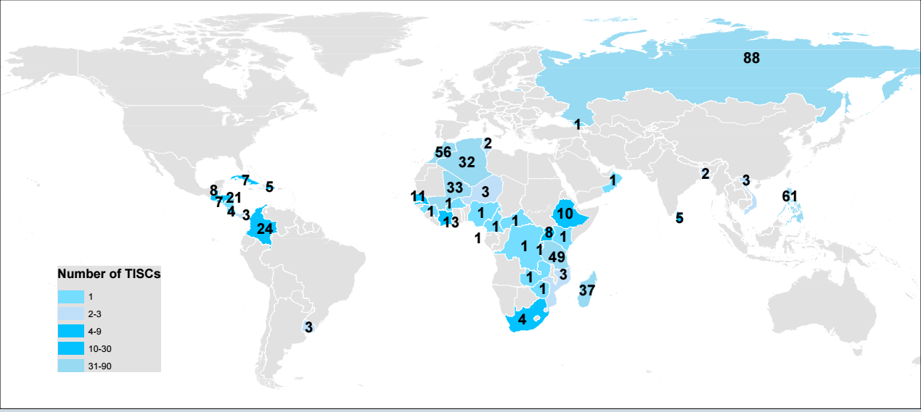
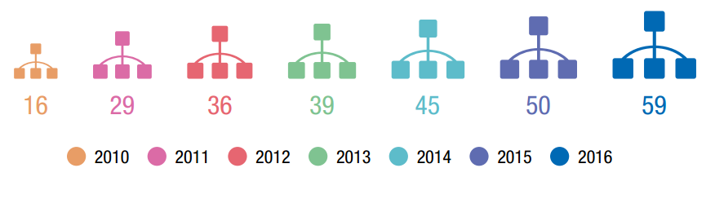
Technology and Innovation Support Centers (TISC)
60 national projects and over 500TISCs worldwide
> 400’000 inquiries supported annually

Slide 19
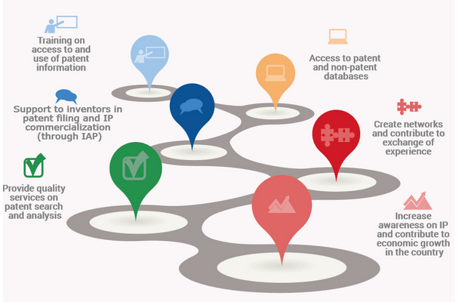
Technology and Innovation Support Centers (TISCs) Services
Core services:
Access to patent and non-patent databases
Assistance in using databases
Additional services (based on user need and office capacity):
Technology search services
Patent analytical services
Awareness-raising and training services

Slide 20
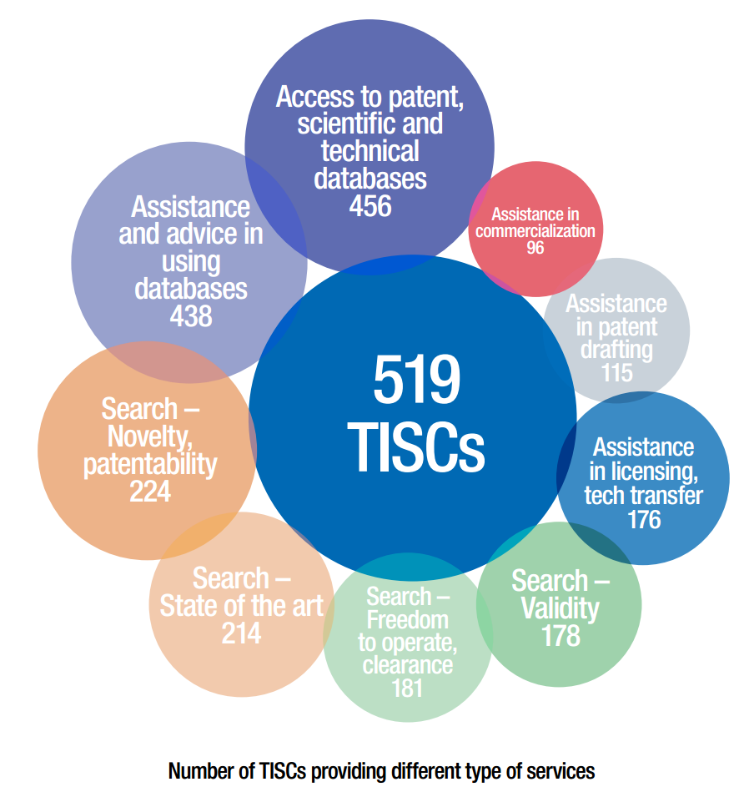
Provision of different services by TISCs
As of end of 2016
Based on theTISC Directory (please update your information!)
Source: Annual TISC report 2016

Slide 21
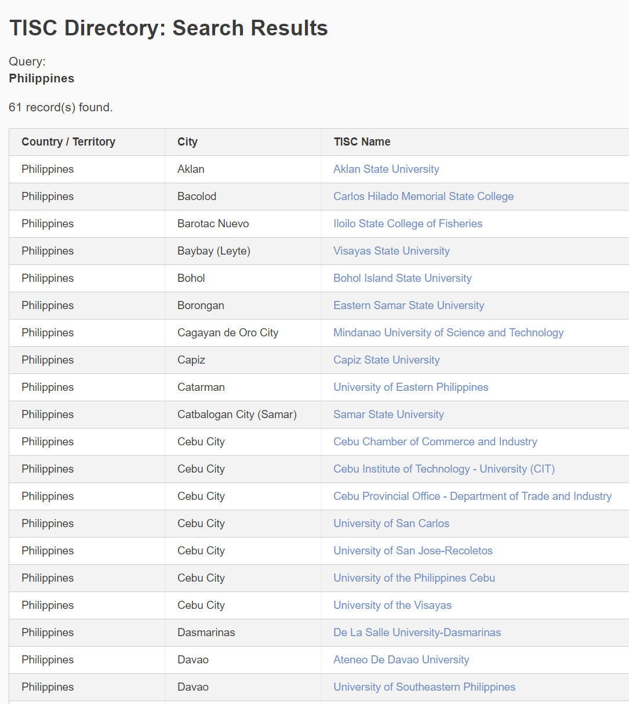
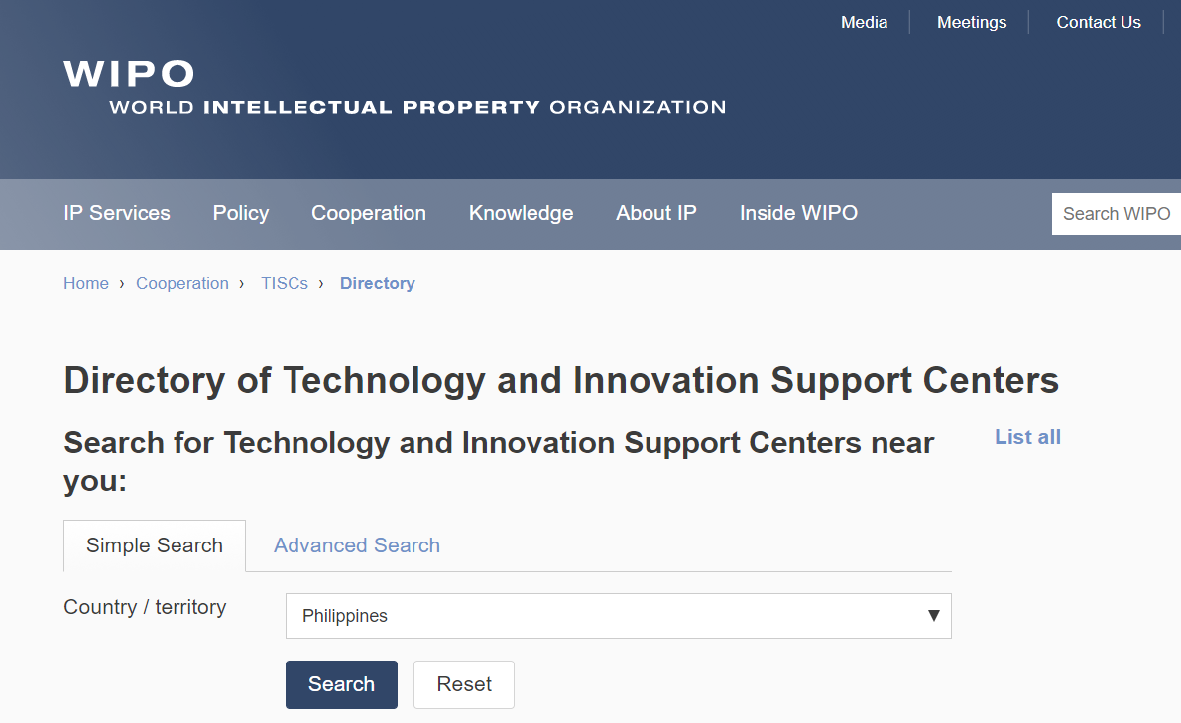

TISC Directory
http://www.wipo.int/tisc/en/search

Slide 22

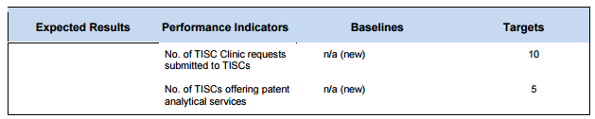
TISC and patent analytics – way forward

Slide 23
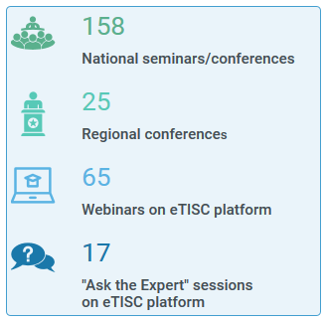
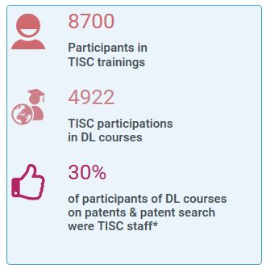
Capacity building
On-site training (including training of trainers)
WIPO Academy Distance learning courses
Webinars and “Ask the Expert” sessions

Slide 24
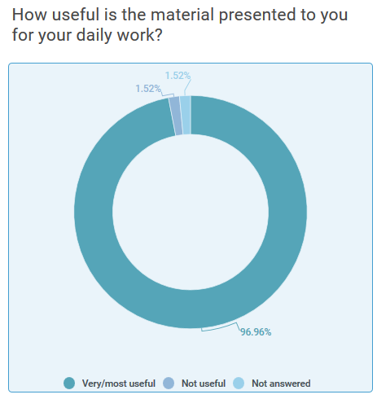

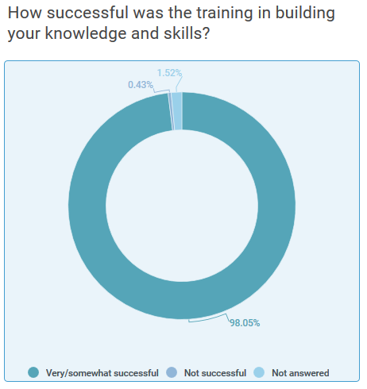
On-site Training and Distance Learning
On- site training types
Training evaluation
Patent documentation
Basic concepts and skills
Patent search
State of the art
Novelty
Freedom to operate
Patent analysis: TISC training area
DL-101: General course on IP
DL-301: Patents
DL-318: Patent information search
Distance Learning Courses

Slide 25
Project on Patents and the Public Domain
Practical guides on the identification and use of inventions in the public domain
Documentation of experiences and best practices in the identification and use of inventions in the public domain
New and enhanced training materials for TISCs
Roster of experts on identification and use of inventions in the public domain
Improved legal status portal

Slide 26
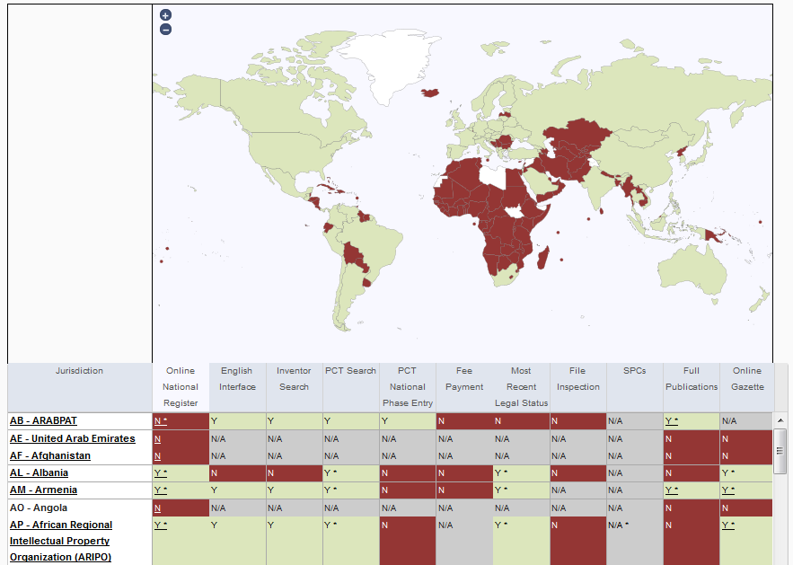
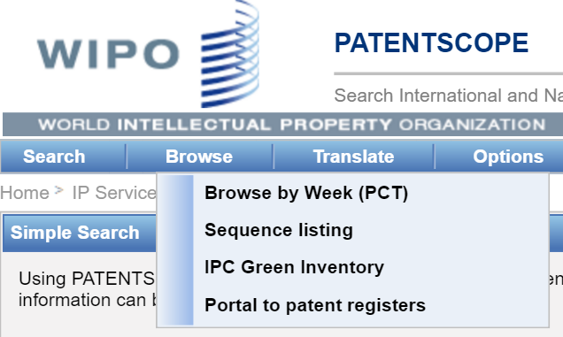
DA Project on the Use of Information in the Public Domain
Improved Patent Register Portal
Portal aims to facilitate the verification of the legal status of patents by compiling relevant information about national registers of various jurisdictions (e.g. availability of online patent register, online gazette etc.)

Slide 27
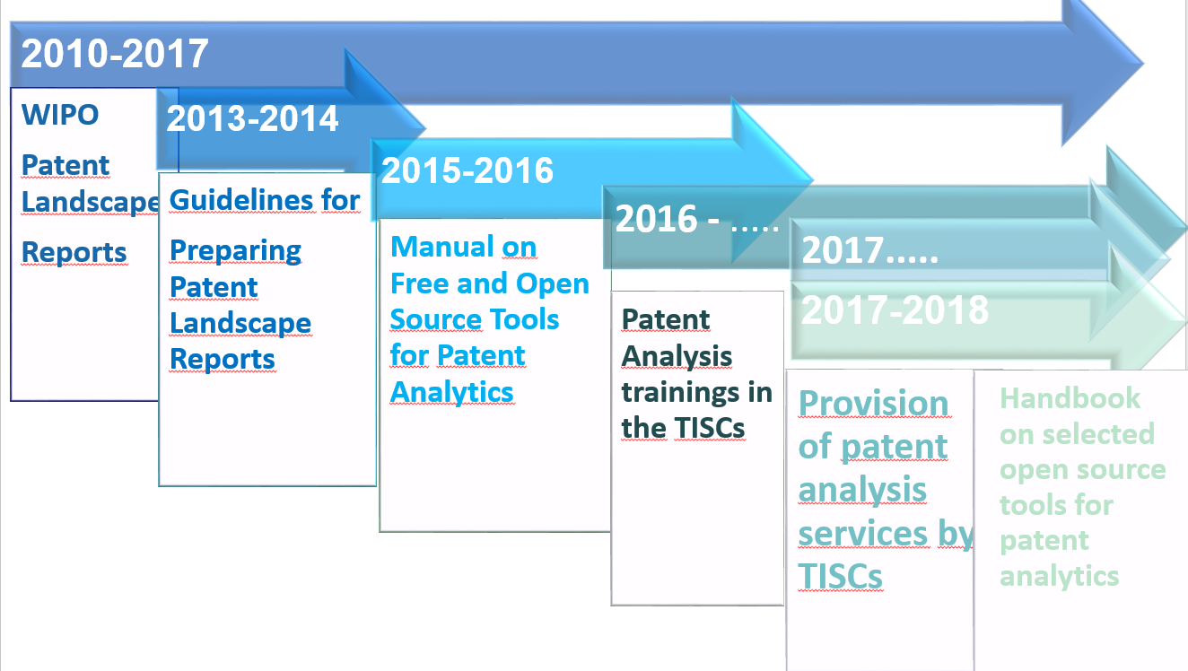
Way forward
TISC: Capacity building activities in the TISCs– support in their building their analytics services
Patent Analytics:
Handbook on selected open source tools for various tasks
Further work on open source tools for patent analysis
New training material and topics for TISC trainings
on patent analytics

Slide 28
tisc@wipo.int
Irene.Kitsara@wipo.int

